Slide 1
The Battle Of Neighborhood
Babloo Sah
Data Scientist

Slide 2
Business Requirement
It has always been difficult for person to accommodate in new society. People spent lot of time in selecting proper Neighborhood while relocating to new places irrespective of their period of stay or reason of relocation (new home, new jobs, better life, opportunities etc.). One thing that people cannot leave behind is the society’s values and their surrounding environment.
There was a period of time when infrastructure was limited but had plenty of time. But today’s scenario are quite different. We have sufficient infrastructure but we lack time. Customer are so calculative about their time and could hardly visit one neighborhood per week. It has been hard task for real estate agent to showcase them appropriate neighborhood. Our data show around 80% of our visiting customer had negative response toward neighborhood that was presented to them. They mostly compare neighborhoods with their current and expect similar or better than that.
We intend to build a model that will select the neighborhood which are similar to customer needs and present us with the list of all possible neighborhood that customer would be interested in. We want most out of our visiting customer to grow our real estate business.

Slide 3
Data
What data We Need?
We will need few specific data from customer to have insight of their neighborhood.
Current Customer city
Relocation city name
Neighborhood details of each city.
Latitude and longitude of each Borough.
Venue details of each neighborhood

Slide 4
Data
Where to collect Data From?
The customer data will be collected from customer requirement form which include current and relocating city.
Neighborhood details of each city will be obtained from government database API.
https://data.gov.in/resources/all-india-pincode-directory
Latitude and longitude of neighborhood will be obtained using Nomatim module from geopy geocoder package.
We will use Foursquare API to obtain venue details of each neighborhood.

Slide 5


Methodology
Data Wrangling step:
Strip extra character from Neighborhood name and group them based on Borough.
After finding the list of neighborhoods, we then connect to the Foursquare API to gather information about venues inside each and every neighborhood. For each neighborhood, we have chosen the radius to be 6000 meter. It means that we have asked Foursquare to find venues that are at most 6000 meter far from the center of the neighborhood.

Slide 6
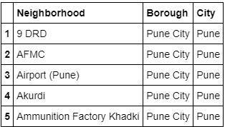
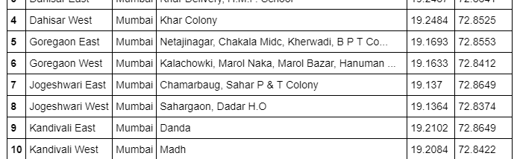
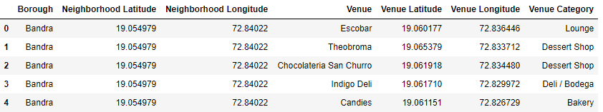
Methodology
How Data Looks post data Wrangling?
Fig: Neighborhood info
Fig: Neighborhood info with Geo location
Fig: Neighborhood info with venue details

Slide 7
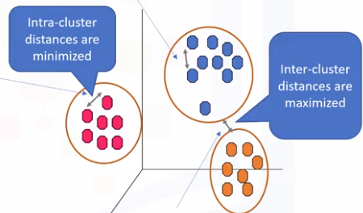
Methodology
Implementing K-means Clustering Algorithm.
K-Means can group data unsupervised based on the similarity of customers to each other.
K-Means minimize the intra-cluster distances and maximize the inter-cluster distances.
Group each Neighborhood based on the
similarity in venues of other neighborhood.

Slide 8
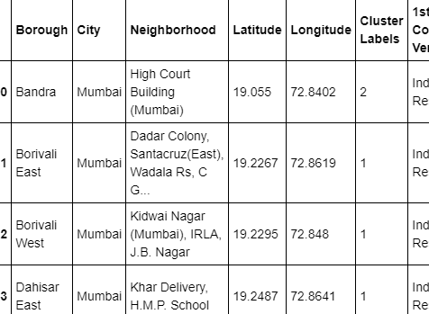
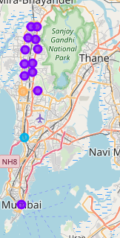
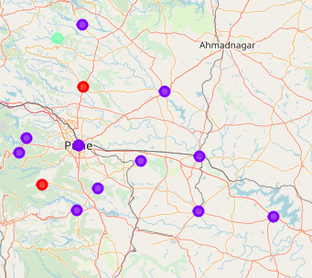
Results
We cluster the similar neighborhood of both the relocating city and current city of customer. By referencing the information extracted from above, we will be able to showcase similar neighborhood to customer
Neighborhood with similar characteristic are represented with similar color.

Slide 9


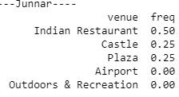
Discussion:
We used Foursquare API to extract venues details of each neighborhood. Based on venue details, the group of similar neighborhood was obtained. Apart from that we can group neighborhood based on trending venues.
As shown in below fig, we can clearly distinguish the type of place and its significance. For example Bhor is a tourist place with landscape while Junnar has historical monuments.

Slide 10

Image is from: https://contenthub-static.grammarly.com/blog/wp-content/uploads/2017/10/thank-you-760x400.jpg

